Slide 1
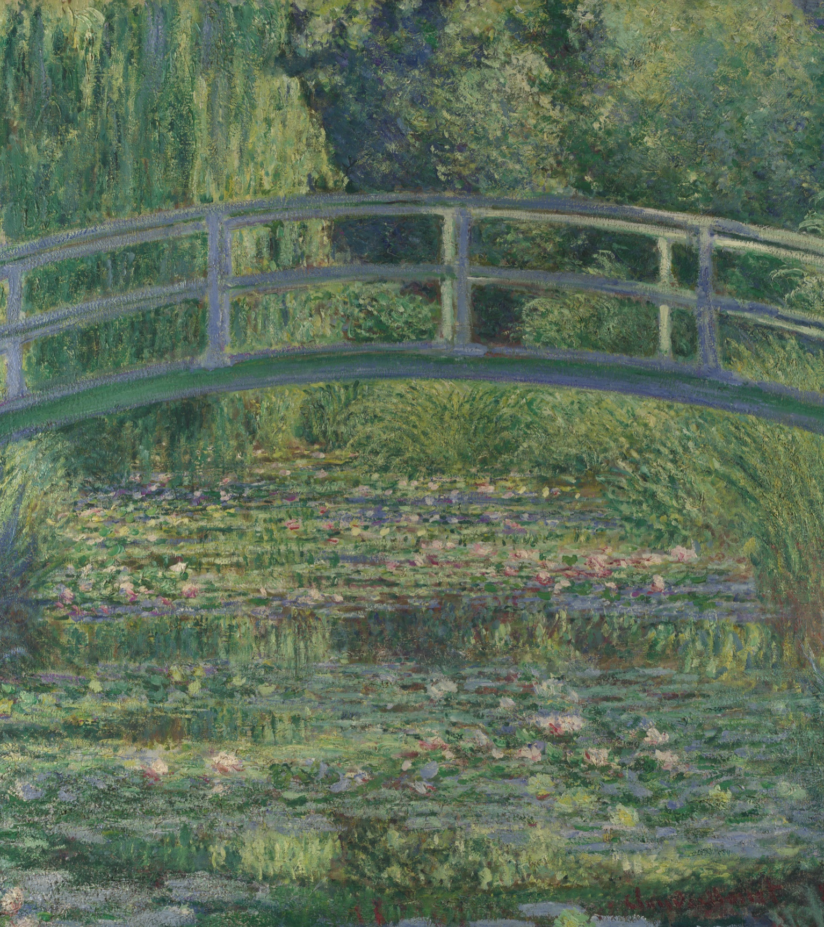
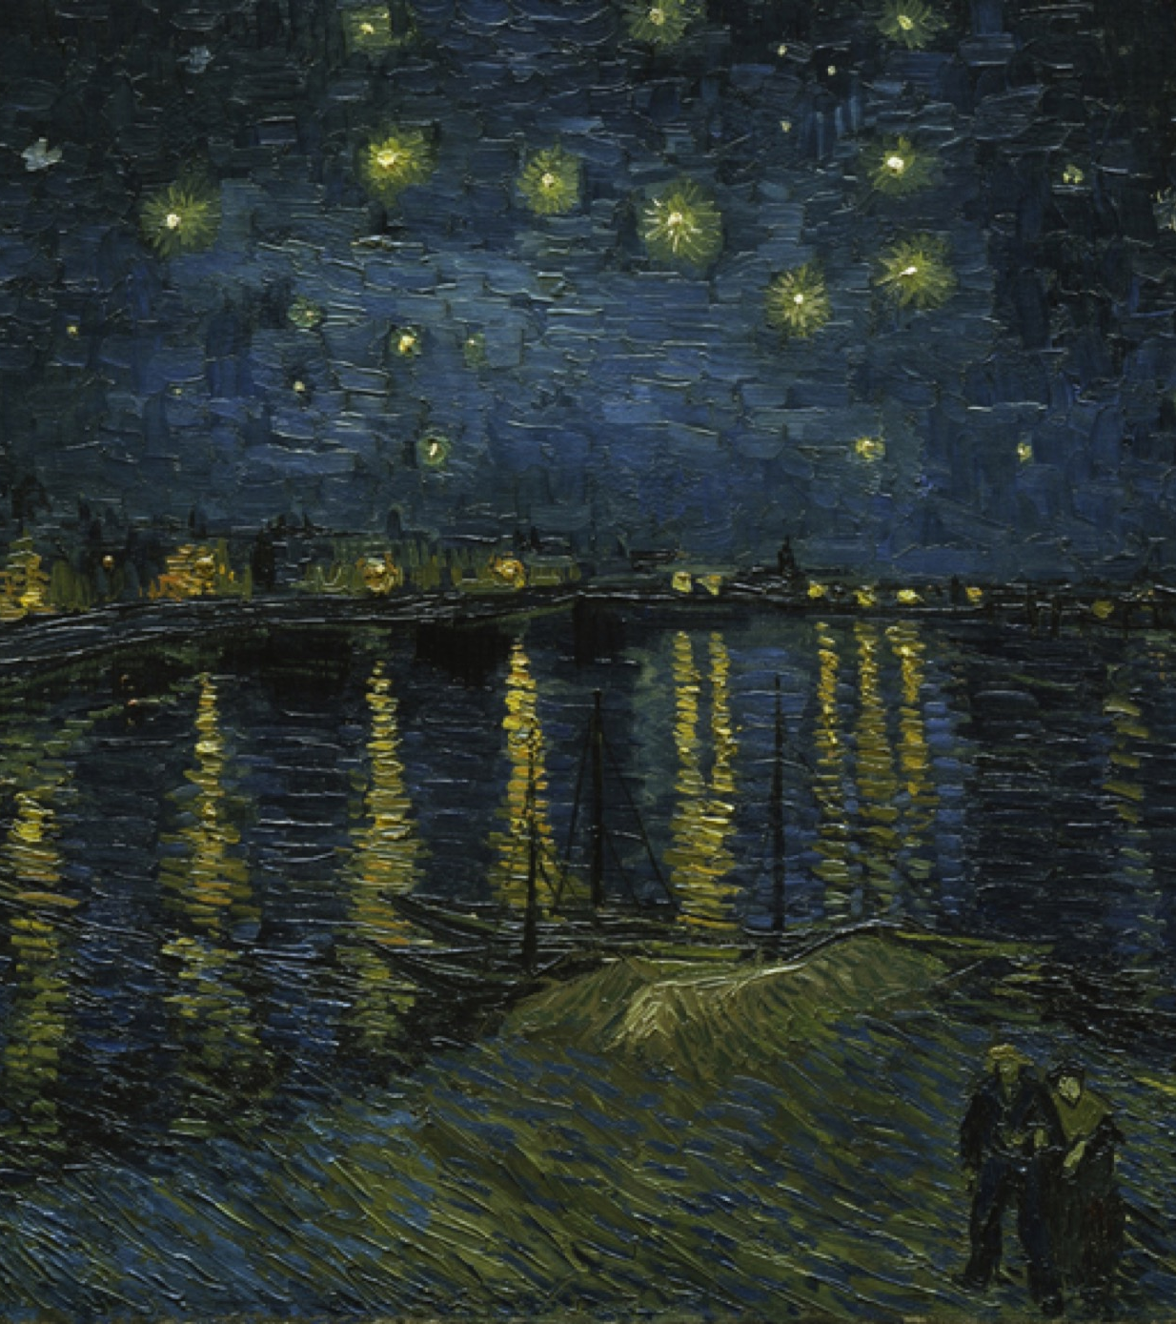
CLASSROOM COMPARISON
Monet
vs Van Gogh
Color, brushwork and the experience of place
How can repeated color and directional marks make a familiar place feel unstable, immersive or emotionally charged?
60-90 minutes / Secondary to undergraduate
Notes:
Introduce the comparison without giving a preferred conclusion. The deck moves from silent looking to object facts, paired evidence and a revisable thesis.
[Sources]
- National Gallery, London: https://www.nationalgallery.org.uk/paintings/claude-monet-the-water-lily-pond
- Musée d'Orsay: https://www.musee-orsay.fr/en/artworks/la-nuit-etoilee-78696

Slide 2
ATLAS OF PAINTINGS / CLASSROOM STUDY / 01
Look before you identify
Record three colors, three directional marks and one question. Do not name the artists yet.
2 minutes / silent
Monet vs Van Gogh
Notes:
Project the slide without reading the prompt aloud twice. After two minutes, ask students to point to the exact location of one observation.
[Sources]
- National Gallery, London: https://www.nationalgallery.org.uk/paintings/claude-monet-the-water-lily-pond
- Musée d'Orsay: https://www.musee-orsay.fr/en/artworks/la-nuit-etoilee-78696

Slide 3
ATLAS OF PAINTINGS / CLASSROOM STUDY / 02
Establish the objects before interpreting
CLAUDE MONET
VINCENT VAN GOGH
The Water-Lily Pond
Starry Night Over the Rhône
1899
Oil on canvas
88.3 × 93.1 cm
The National Gallery, London
1888
Oil on canvas
72.5 × 92 cm
Musée d'Orsay, Paris
OBJECT FACT ≠ INTERPRETATION
Keep title, date, medium, dimensions and holding institution stable while claims remain open to revision.
Monet vs Van Gogh
Notes:
Reveal the records and ask students which statements are object facts. Clarify that dimensions and institutional titles should come from the holding museum, not from image-search captions.
[Sources]
- National Gallery, London: https://www.nationalgallery.org.uk/paintings/claude-monet-the-water-lily-pond
- Musée d'Orsay: https://www.musee-orsay.fr/en/artworks/la-nuit-etoilee-78696

Slide 4
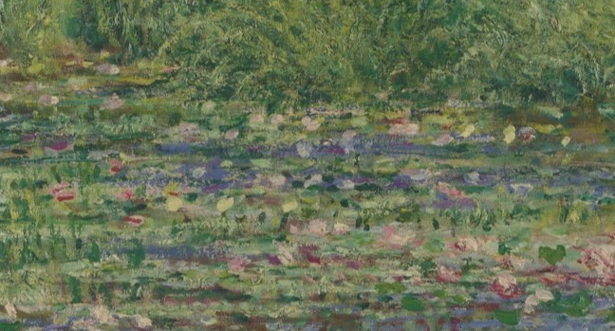
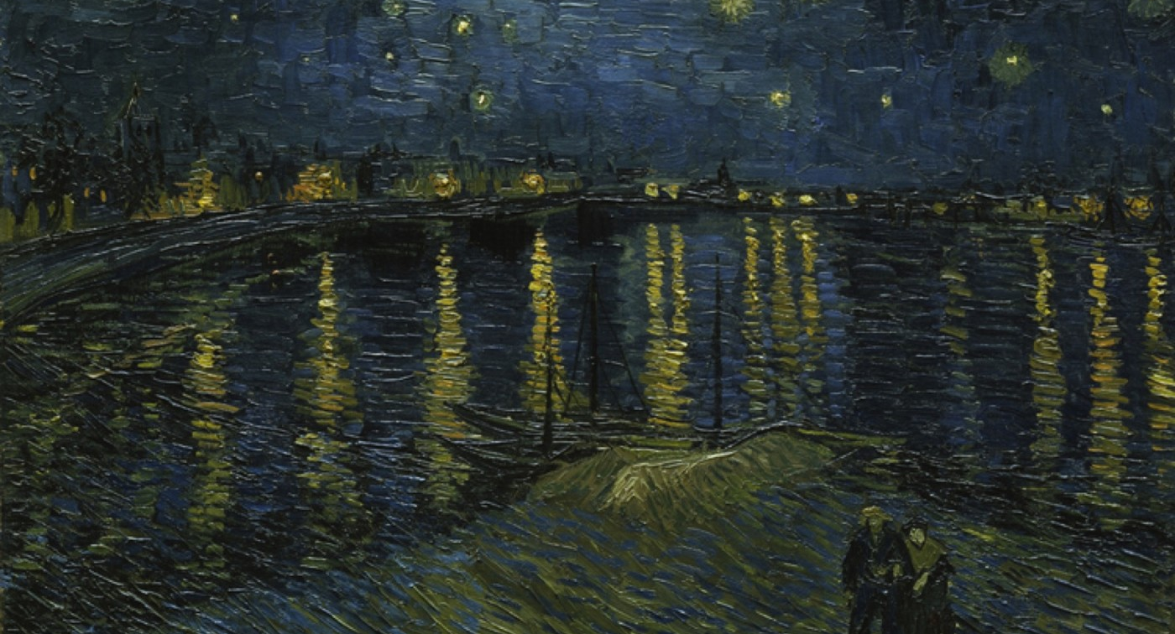
ATLAS OF PAINTINGS / CLASSROOM STUDY / 03
Evidence pair 1 / Surface and depth
Where does the painted surface stop behaving like a transparent window?
RELATION
Monet collapses depth; Van Gogh keeps broad zones.
A / MONET
B / VAN GOGH
Reflected vegetation makes the pond oscillate between surface and depth.
Different blue stroke systems keep sky and river related but distinct.
Monet vs Van Gogh
Notes:
Ask for description before revealing the supplied claims. Then test the relationship: what is visible, where is it located and what changes when the crop returns to the complete work?
[Sources]
- National Gallery, London: https://www.nationalgallery.org.uk/paintings/claude-monet-the-water-lily-pond
- Musée d'Orsay: https://www.musee-orsay.fr/en/artworks/la-nuit-etoilee-78696
- Atlas of Paintings curated comparison: /research/comparisons/monet-vs-van-gogh-color-brushwork

Slide 5
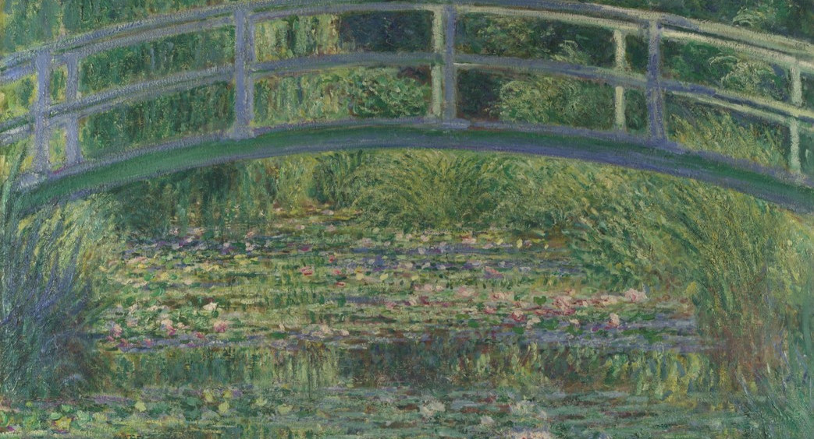
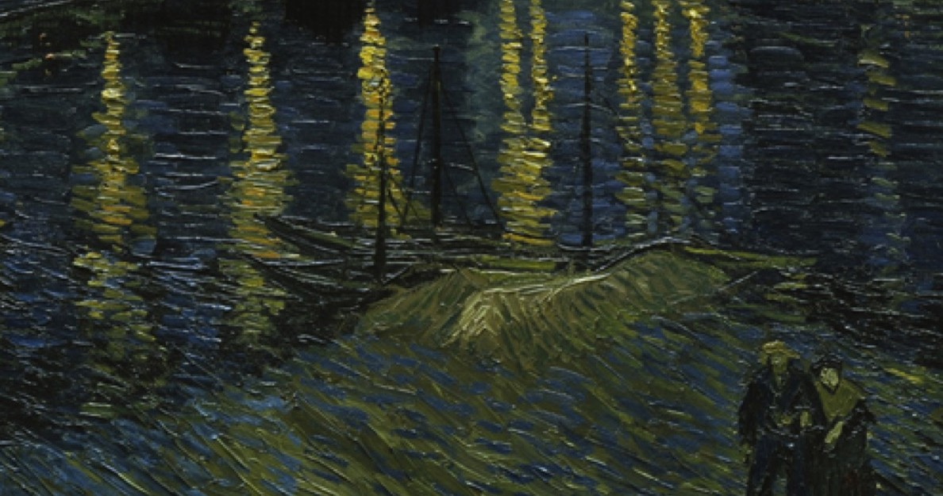
ATLAS OF PAINTINGS / CLASSROOM STUDY / 04
Evidence pair 2 / Color structure
Can one dominant color carry several visual functions?
RELATION
One color family versus warm marks against blue.
A / MONET
B / VAN GOGH
Green differentiates foliage, shadow, water and reflected growth.
Gold reflections convert distant lamps into paths toward the viewer.
Monet vs Van Gogh
Notes:
Ask for description before revealing the supplied claims. Then test the relationship: what is visible, where is it located and what changes when the crop returns to the complete work?
[Sources]
- National Gallery, London: https://www.nationalgallery.org.uk/paintings/claude-monet-the-water-lily-pond
- Musée d'Orsay: https://www.musee-orsay.fr/en/artworks/la-nuit-etoilee-78696
- Atlas of Paintings curated comparison: /research/comparisons/monet-vs-van-gogh-color-brushwork

Slide 6
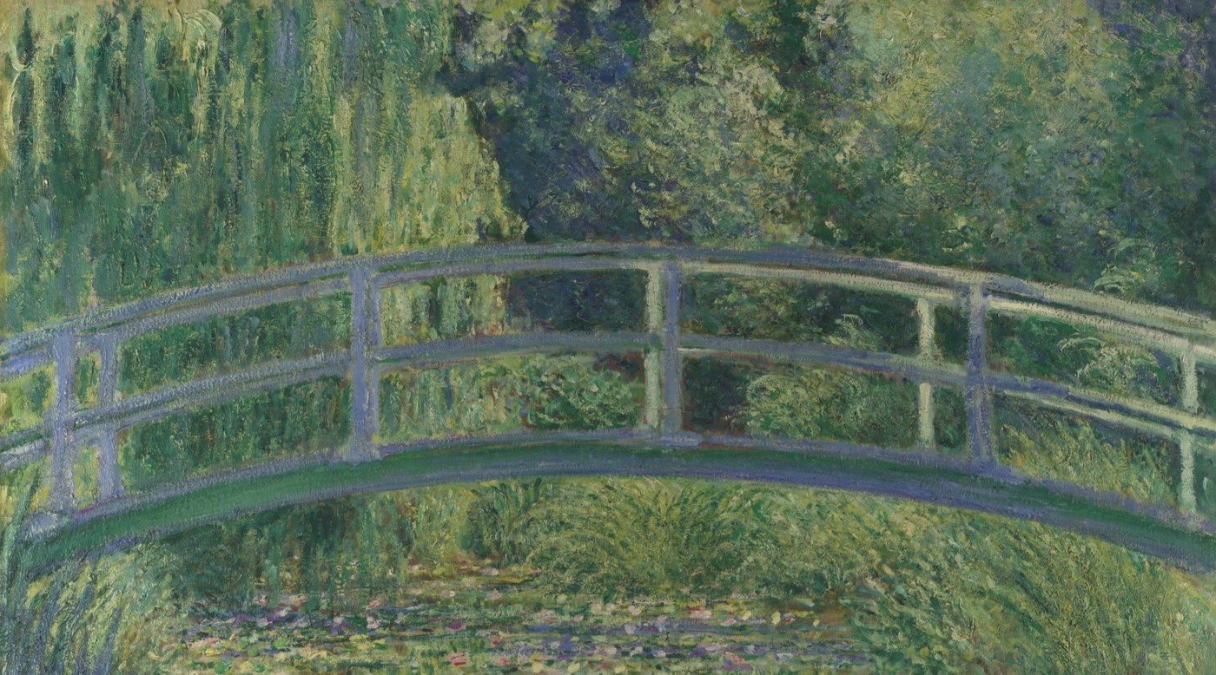
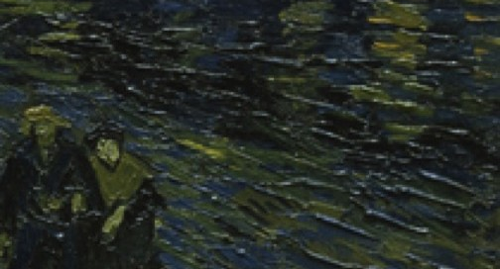
ATLAS OF PAINTINGS / CLASSROOM STUDY / 05
Evidence pair 3 / Human access
How is the viewer positioned in relation to the painted place?
RELATION
Enclosure versus intimacy inside distance.
A / MONET
B / VAN GOGH
Dense vegetation closes the horizon and surrounds the viewer.
A small foreground couple gives the river and sky a measurable human scale.
Monet vs Van Gogh
Notes:
Ask for description before revealing the supplied claims. Then test the relationship: what is visible, where is it located and what changes when the crop returns to the complete work?
[Sources]
- National Gallery, London: https://www.nationalgallery.org.uk/paintings/claude-monet-the-water-lily-pond
- Musée d'Orsay: https://www.musee-orsay.fr/en/artworks/la-nuit-etoilee-78696
- Atlas of Paintings curated comparison: /research/comparisons/monet-vs-van-gogh-color-brushwork

Slide 7
ATLAS OF PAINTINGS / CLASSROOM STUDY / 06
Small-group comparison: build one relationship
01
02
03
04
Choose
Locate
Connect
Explain
Select one evidence pair.
Point to the exact visible detail in both images.
Use because, while or whereas to state a relationship.
Say what changes: attention, space, emotion, time or meaning.
Relationship sentence
Although both paintings ______________________, Monet ______________________, whereas Van Gogh ______________________; this changes ______________________.
Monet vs Van Gogh
Notes:
Give groups five to eight minutes. Require a single relationship rather than two separate descriptions. Ask one speaker to point to the evidence while another reads the sentence.
[Sources]
- Atlas of Paintings curated comparison: /research/comparisons/monet-vs-van-gogh-color-brushwork

Slide 8
ATLAS OF PAINTINGS / CLASSROOM STUDY / 07
Revise the claim, then leave with a question
EDITABLE THESIS
Although both paintings loosen descriptive color to intensify place, Monet uses layered greens and unstable reflection to dissolve surface and depth, while Van Gogh uses separated blue fields and directional gold marks to connect cosmic, urban and human scales.
EXIT TICKET
1
Which word in the thesis is least precise?
2
What new evidence would strengthen or overturn it?
3
What would you compare next?
Continue: worksheet → comparison tool → citations → research export
Monet vs Van Gogh
Notes:
Treat this thesis as a strong draft, not the answer key. Ask students to replace one vague word, add one evidence location and name a next comparison that could test the claim.
[Sources]
- Atlas of Paintings curated comparison: /research/comparisons/monet-vs-van-gogh-color-brushwork
- National Gallery, London: https://www.nationalgallery.org.uk/paintings/claude-monet-the-water-lily-pond
- Musée d'Orsay: https://www.musee-orsay.fr/en/artworks/la-nuit-etoilee-78696

